Slide 1

Title: ApexWolf – AI Powered Dynamic Pricing System Team: Wolf Pack College: Prince Shri Venkateshwara Padmavathy Engineering College Use Case: Dynamic Pricing Of Financial Products Faculty Mentor: Dr. Venkata Subramanian Dayanandan

Slide 2

Problem Statement — Rigid Banking Structures
❝Static Interest Rates Fail to Reflect Financial Reality❞
Most banks follow static pricing models with fixed slab rates for home loans and FDs. These models ignore personalized data like:
Customer loyalty or association duration
Credit history, repayment track
Income and employment profile
Investment behavior
Market fluctuations
As a result, deserving customers do not receive better rates, and banks often risk high defaults by misclassifying applicants.

Slide 3
Our Solution
💡 ApexWolf – AI Powered Dynamic Pricing System
Predicts interest rates, tenures, and risk labels using ML ensembles (CatBoost, LightGBM, XGBoost).
Users submit justifications for better rates, auto-tagged via NLP sentiment analysis for admin review.
Eligibility calculated via dynamic, weight-based scoring logic—admin-configurable by role and profile.
End-to-end loan processing with agreement generation, PDF parsing, surplus handling, and final reporting.
Role-specific dashboards ensure secure access to admin and user modules, with complete feature isolation.
Accessibility-first design includes voice commands, high-contrast modes, and exportable reports (PDF/CSV).

Slide 4
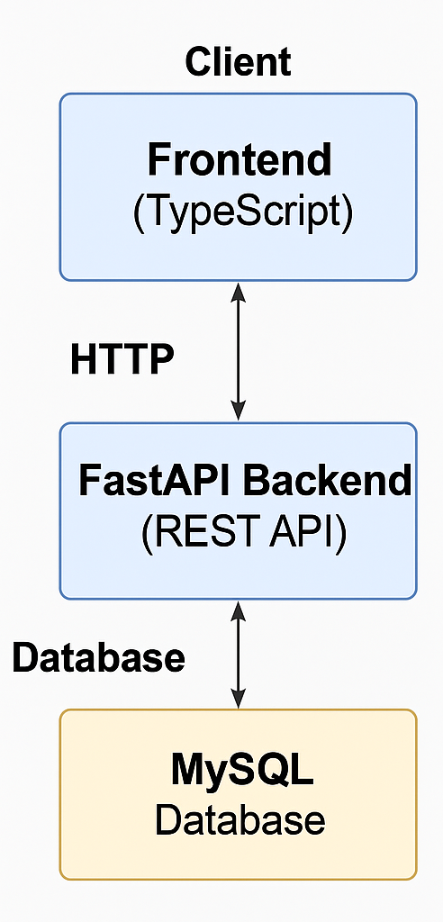
System Overview
ApexWolf is a comprehensive platform that uses predictive analytics to determine optimal loan/investment pricing.
The application follows a modular three-tiered architecture: Presentation (React), Business Logic (FastAPI), and Data Services (MySQL, CSV, ML models).
Both Admin and User dashboards operate on distinct role-based rendering logic with secure login, session control, and feature segregation.

Slide 5
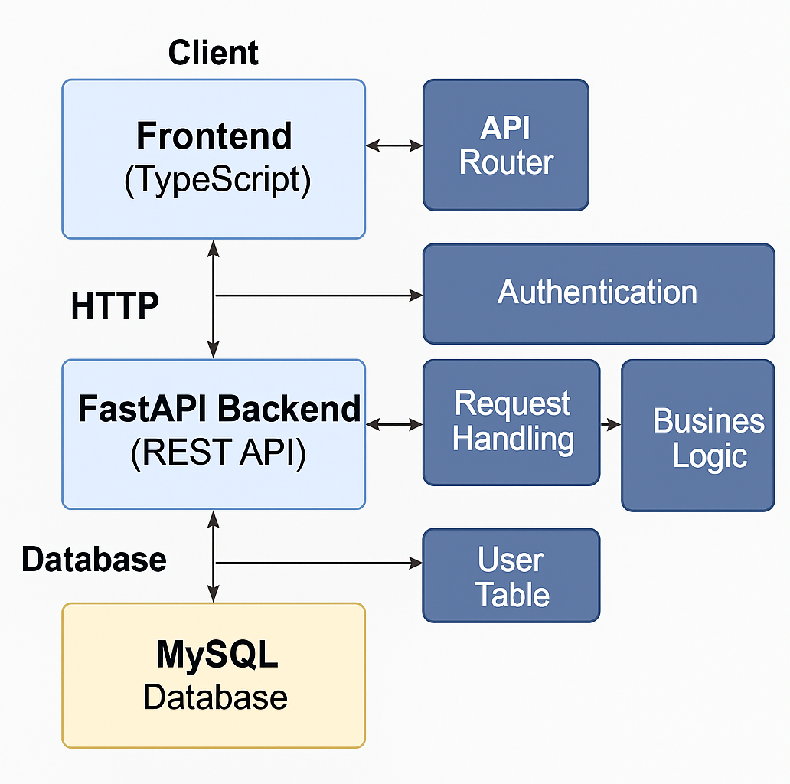
Core Architecture and Technologies
Frontend: React.js with dynamic routing and role-based UI rendering
Backend: FastAPI + Python, with REST endpoints for loan scoring, investment simulation, and admin controls
Database: MySQL relational schema with data normalization and logging tables
ML Integration: CatBoost, LightGBM, XGBoost used via pickled .pkl models served via inference engine
Security: Session-based authentication and admin-only route control

Slide 6
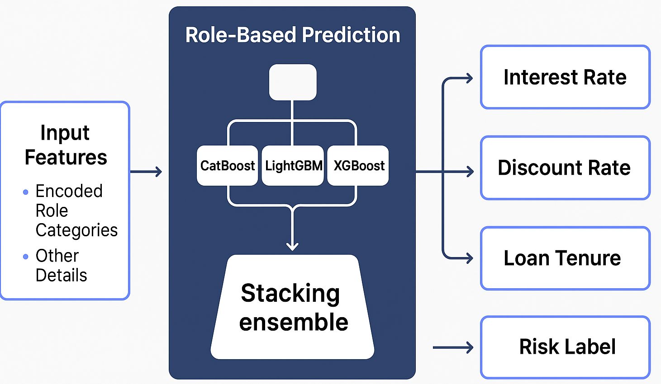
Role-Based Prediction
User: Fills input form with role, employment type, and income; data sent to backend for ML inference.
ML Layer: Uses ensemble strategy (CatBoost + LightGBM + XGBoost) to predict optimal interest rate, tenure, and risk band.
Admin: Accesses detailed prediction logs, inputs, timestamps, model confidence scores; can trigger model retraining pipeline or view model metadata.

Slide 7
Loan Eligibility Prediction Engine
User Side:
Form dynamically adapts to “Employed” or “Unemployed” with variable input fields per user type.
A formulaic scoring engine (Polynomial Regression) computes eligibility based on admin-defined weights.
Displays clear eligibility verdict with confidence score.
Admin Side:
Can adjust weight coefficients (e.g., age: 0.2, income: 0.5) per employment type via config dashboard.
Access logs, download eligibility decisions, and override automated results if necessary.

Slide 8
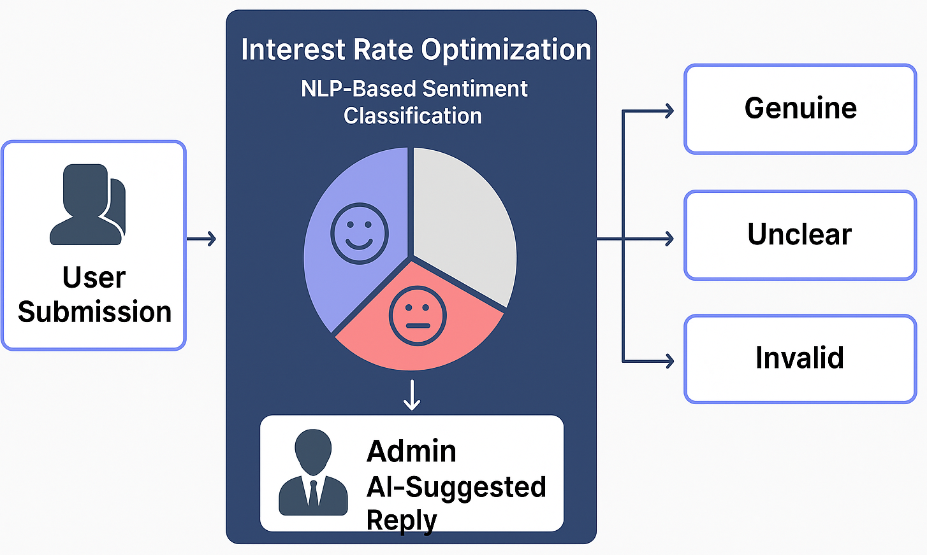
Interest Rate Optimization
User Side:
Submits personalized request for a reduced interest rate, accompanied by justification and documents.
The backend NLP pipeline performs sentiment analysis on justification text and classifies as “Genuine”, “Ambiguous”, or “Invalid”.
Admin Side:
Reviews flagged requests with sentiment tags, compares with uploaded proof.
Accepts, modifies, or rejects user request with final interest decision and AI-suggested reply.

Slide 9
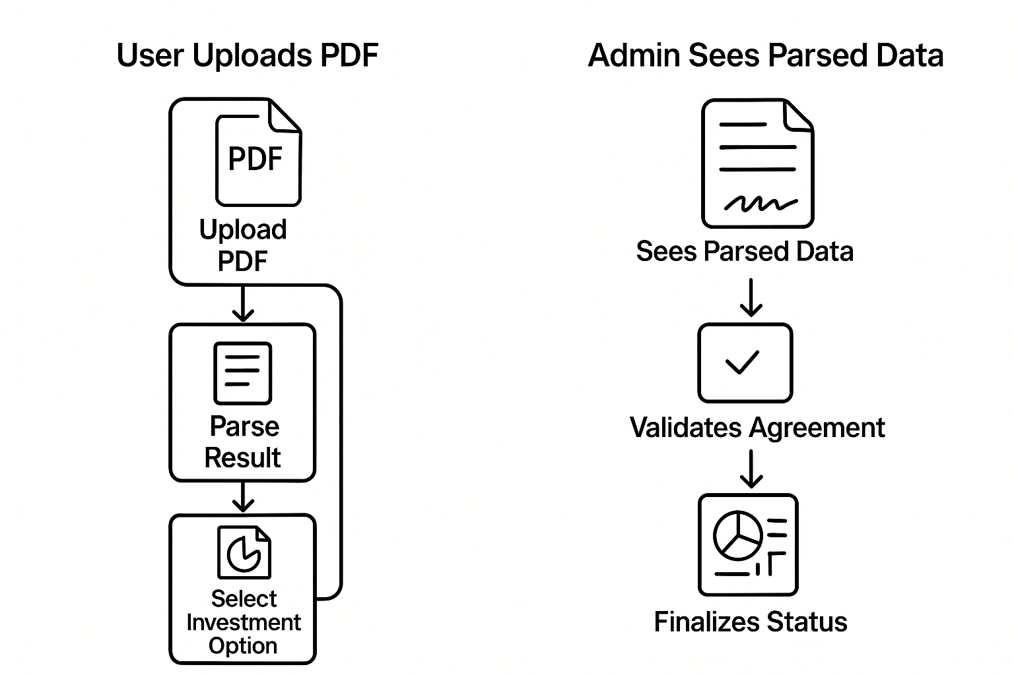
Loan Processing & Agreement
User Side:
Uploads ML-generated prediction PDF → system parses metadata (rate, tenure).
Digitally signs loan agreement; chooses to invest surplus (if sanctioned > requested).
Final signed documents and summary reports are downloadable.
Admin Side:
Validates uploaded PDFs; ensures prediction values are unaltered.
Reviews agreement terms and uploads countersigned docs.
Finalizes and approves/disapproves processing.

Slide 10
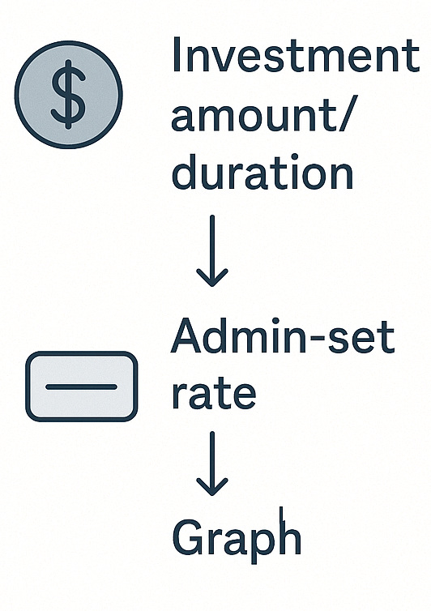
Smart Investment Tracker
User Side – Predict Mode:
Inputs investment amount, tenure, start month; returns projected value via compound interest using admin-set rate.
Visual output in line chart + numeric summary.
User Side – Track Mode:
Tracks portfolio progress based on actual NAV growth. Shows real-time delta, gain/loss vs projection.
Admin Side:
Updates NAV and base interest values; sets them as static or dynamic.
Accesses investment logs, trend reports, and user history.

Slide 11
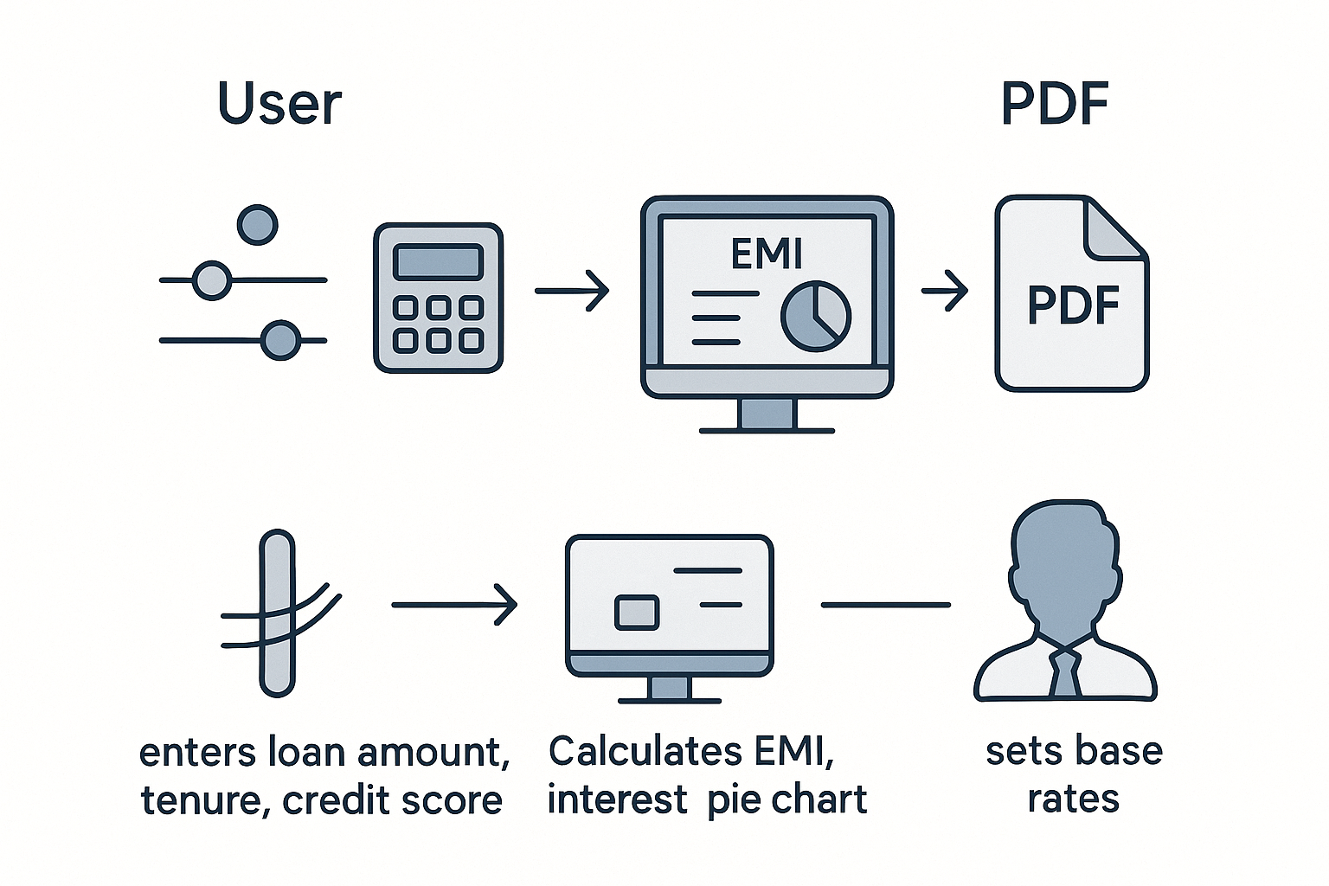
Loan Simulator Engine
User Side:
Inputs loan amount, tenure, and credit score using sliders or manual entry.
Output includes EMI amount, total interest, full amortization schedule, and pie chart of principal vs interest.
Can download schedule in PDF.
Admin Side:
Configures base interest rate which prepopulates the simulator.
Reviews usage logs for user sessions and simulated values; can download data in CSV.

Slide 12
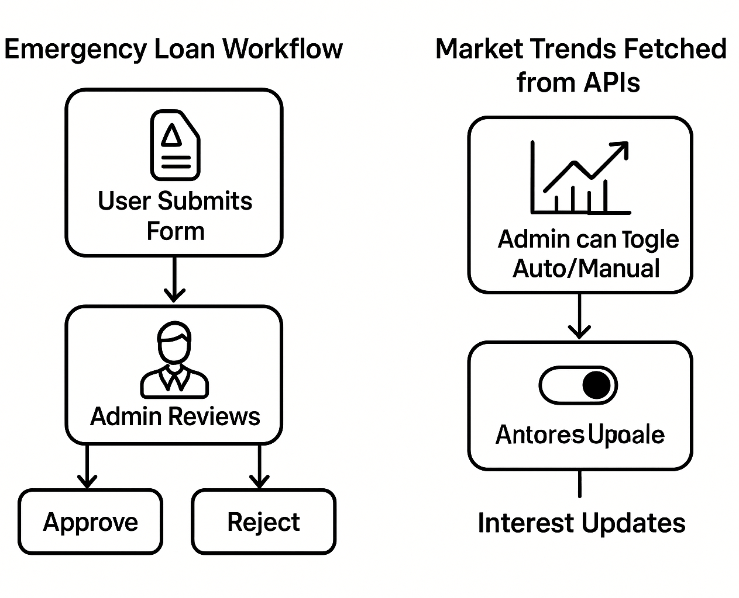
Emergency Loan & Market Trends
User Side:
Submits emergency loan application with reason and document proof.
Accesses live bank rate comparison and global indicators like Nifty, Nasdaq.
Admin Side:
Reviews application; validates urgency through sentiment tagging and supporting evidence.
Approves or rejects with optional special interest consideration.

Slide 13
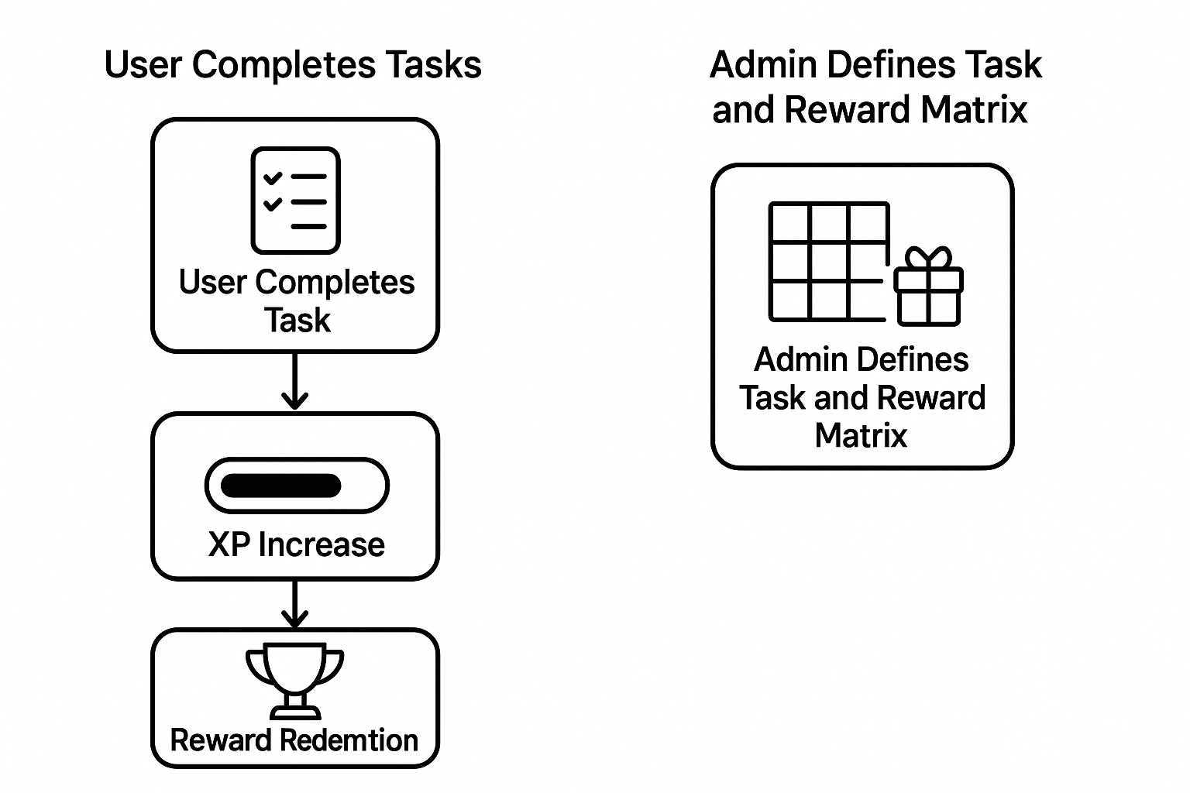
Tasks, Rewards & Gamification
User Side:
Completes tasks (e.g., submit feedback, repay on time) to earn XP.
Redeems points for predefined benefits or status upgrades.
Admin Side:
Defines tasks and XP values; configures redemption rules.
Reviews user progress and reward logs for performance metrics.

Slide 14
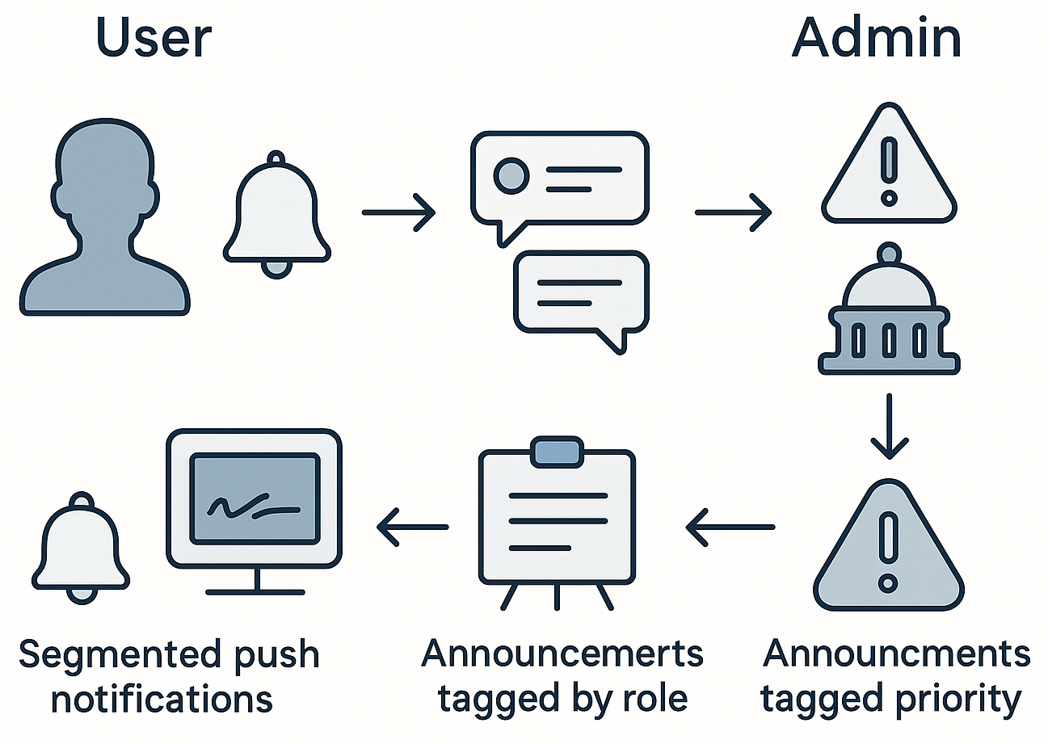
Notification Centre & Announcement Banner
User:
Receives push updates (reminders, policy changes)
Views real-time RBI/Govt monetary headlines
Admin:
Sends role-segmented, priority-tagged notifications
Configures announcement banner with live source link

Slide 15
Repayment & Badges
User
Tracks EMI status, outstanding balance, and repayment progress using a dynamic timeline.
Awards badges and XP based on timely repayments, early closures, and financial engagement.
XP can be redeemed for benefits through the platform’s integrated rewards system.
Admin
Configures badge criteria, XP thresholds, and redeemable rewards via a gamification panel.
Monitors user progress, redemption logs, and issues overrides when necessary.
Analyzes system-wide engagement to adjust reward dynamics in real time.

Slide 16
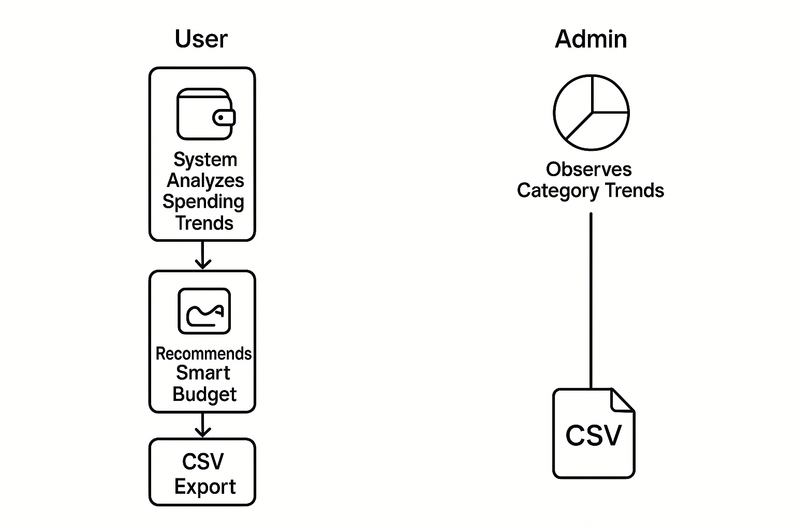
Expense Tracker & Budgeting
User Side:
Logs expenditures by date, category, and amount.
Dashboard presents spending distribution (pie chart), daily trendline, and auto-suggested smart budgets.
Option to export in CSV.
Admin Side:
Can view anonymous spending pattern analytics for economic trend evaluation.
No direct editing, ensures privacy compliance.

Slide 17
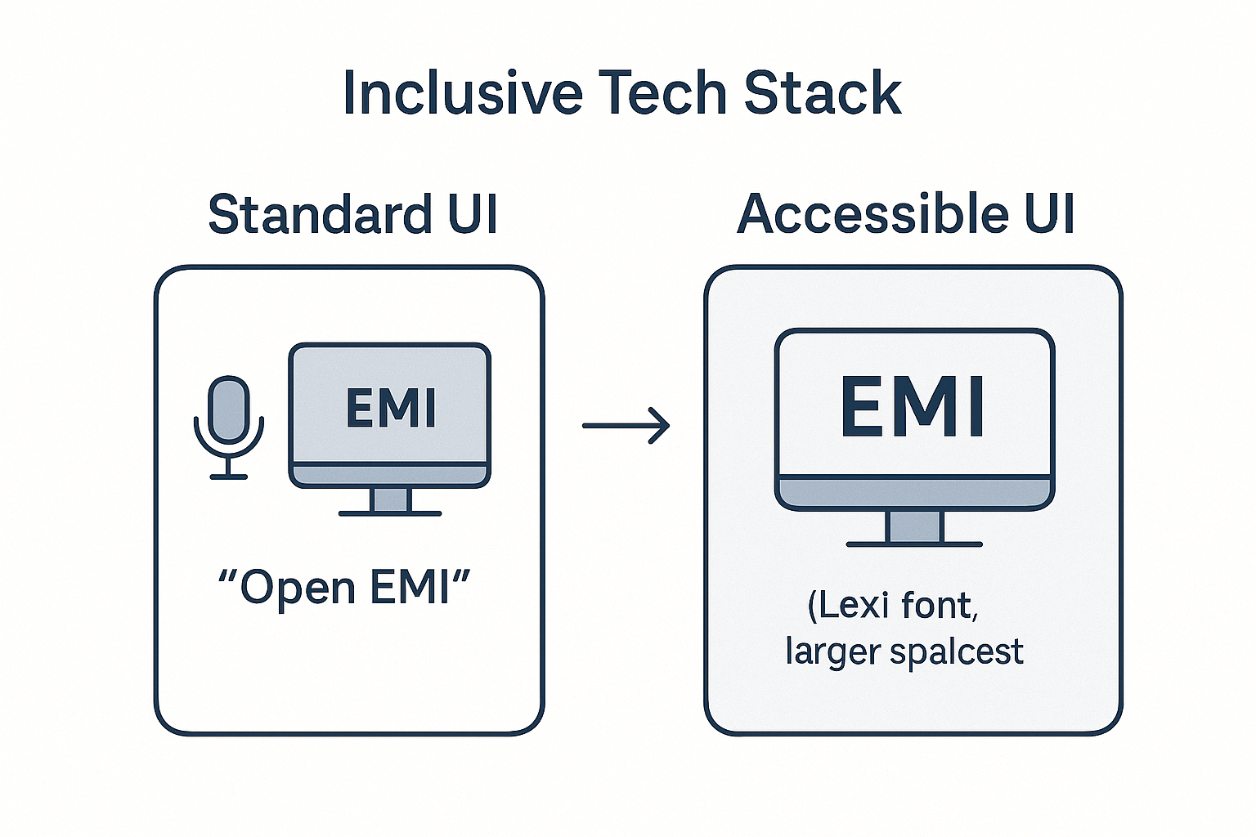
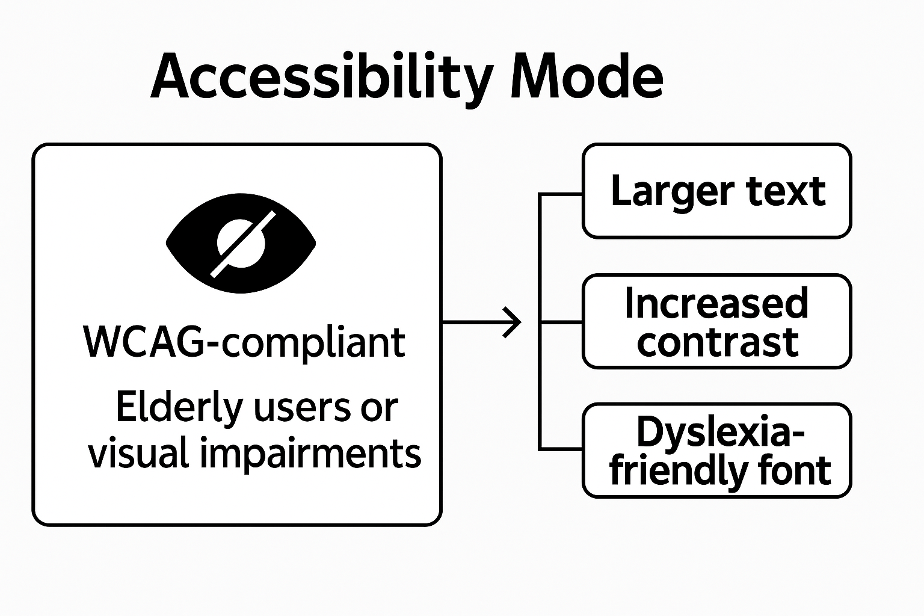
Accessibility Mode & Voice Control
Accessible Mode includes Lexi-readable fonts, high-contrast themes, adjustable spacing, and colorblind-safe palettes.
WCAG 2.1 compliance ensures usability for visually impaired and dyslexic users.
Voice Control uses Web Speech API to navigate core features via commands like “Open Loan Simulator”.

Slide 18
Core Functional Modules
Module | Description
Role-Based Prediction | Uses ML ensemble (CatBoost, XGBoost, LightGBM) to predict interest rate, risk label, and tenure.
Loan Eligibility | Applies polynomial regression; user type–specific forms; admin-adjustable scoring weights.
Interest Rate Optimization | NLP evaluates uploaded justifications and classifies them as Genuine, Unclear, or Invalid.
Loan Simulator | EMI simulation using sliders; outputs pie chart, full schedule, and downloadable PDF reports.
Loan Processing Flow | Parses predictions, builds agreements, manages surplus investments, and creates a final report.

Slide 19
Supporting Functional Modules (1/2)
Module | Description
Smart Investment | Offers SIP forecast and performance tracking using NAV set by admin; includes dynamic graphs.
Emergency Loan | Users upload docs for urgent loans; admin approves with risk-based rate adjustments.
Market Trends | Displays interest rate comparisons and international indices like Nifty, Nasdaq, and S&P.
Expense Tracker | Categorized expense logging with charts, trendlines, smart budget tips, and CSV export.
Rewards & Badges | Gamified XP system; users earn and redeem points; all task/reward logic managed by admin.

Slide 20
Supporting Functional Modules (2/2)
Module | Description
Repo Rate Monitor | Shows RBI repo & reverse repo rates, 5-year trends, last updated data; auto-fetched from RBI site.
PDF/CSV Export Tools | Downloadable PDF/CSV reports in Investment, Loan Simulator, Processing, and Feedback modules.
Announcement Banner | Streams real-time RBI and Government updates; links to verified sources for press releases.
Notifications | Admin-configured alerts (info/reminder/urgent); shown on user dashboards.
Chatbot & Support Panel | Static chatbot with FAQ redirection; contact numbers and categories available in support view.

Slide 21
Non-Functional & Inclusive Features (1/2)
Feature | Description
Accessible Mode Toggle | Enables Lexi-readable fonts, high-contrast themes, colorblind-safe palettes, and text spacing.
Voice Navigation | Browser-based Web Speech API allows voice commands to navigate core modules.
User Manual | Available throughout the dashboard; offers downloadable visual guide for full platform navigation.
Secure Logout | Ends session from backend; clears tokens and ensures role-based reauthentication.
Sidebar Navigation | Fully responsive and collapsible; dynamically displays based on user type (admin/user).

Slide 22
Non-Functional & Inclusive Features (2/2)
Feature | Description
Login & Signup Panel | Signup restricted to users; MySQL-based auth; secure admin access enabled only via backend entry.
Admin Access Restrictions | Sensitive views and routes are protected and only rendered after role verification.
System Logs | Monitors server errors, file parse failures, invalid payloads; alerts sent to dev dashboard.
Privacy Settings | Includes theme preferences, profile settings, security toggles, and notification configuration.
Biometric Profile Module | Stores identity, address, financial, and document info; used solely for record-keeping and audit.

Slide 23
Future Enhancements & Vision
From Intelligent Pricing to Unified Financial Awareness
We’re already building what's next:
Unified Banking View A smart dashboard linking all user accounts, loans, and savings — regardless of the bank — into one intelligent, real-time summary
Auto-Generated Financial Reports Downloadable monthly snapshots: “Here’s what you owe. Here’s what you own.”
LLM-Powered Negotiation & Guidance Using AI to help users justify better rates and generate smarter investment advice
🎯 We envision a future where banking becomes transparent, responsive, and centered around people — not just numbers.

Slide 24
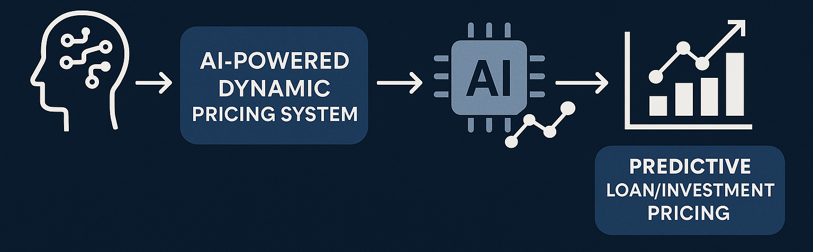
Why ApexWolf Stands Out
Combines ML-driven pricing intelligence with formulaic overrides for regulated environments.
Inclusive design: Accessibility Mode, Voice Control, Role-based UI segregation, Static Chatbot for non-technical users.
Full lifecycle coverage: Prediction → Negotiation → Agreement → Investment → Repayment → Rewards.
Robust admin governance: Overridable rules, feedback loops, logs, and real-time audit trail.

